Slide 1
IDS PROJECT
Australian weather analysis
BY
1.TUSHAR DIXIT
2.G GHANA GOKUL 3.WARIS K R

Slide 2



INTRODUCTION
This dataset from kaggle contains about 10 years of daily weather observations from numerous Australian weather stations.
And we will use this data set to analyze different attributes of the weather.
Also we will try to forecast weather based on these attributes.

Slide 3

OBJECTIVES
Data cleaning Preprocessing Data visualization Standardization
Prediction

Slide 4

Importing the basic libraries

Slide 5
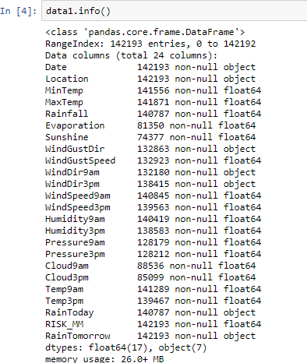
Data Types of the Following Attributes
we can see that most of our attributes are float and object type.

Slide 6
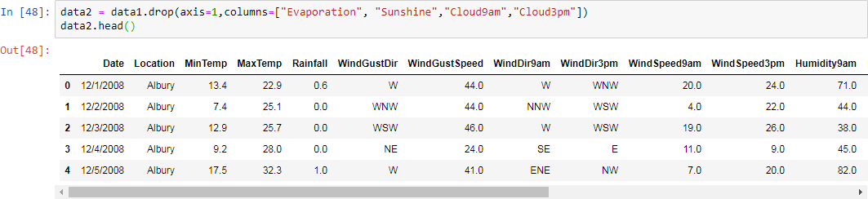
Data cleaning
The above mentioned columns have lot of NaN values so removing then from our dataset.

Slide 7
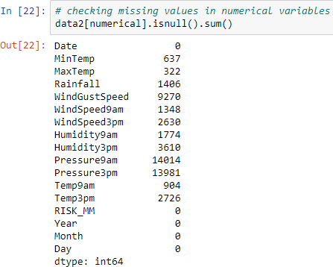
Data cleaning
- handling missing values
Before cleaning we have these many missing values in respected columns

Slide 8
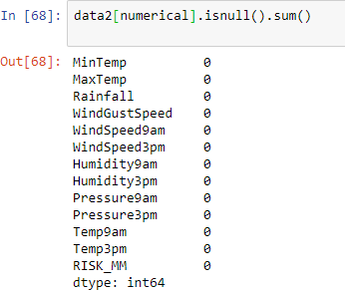
Data cleaning
- handling missing values
After cleaning
using below code we don't have any missing values

Slide 9
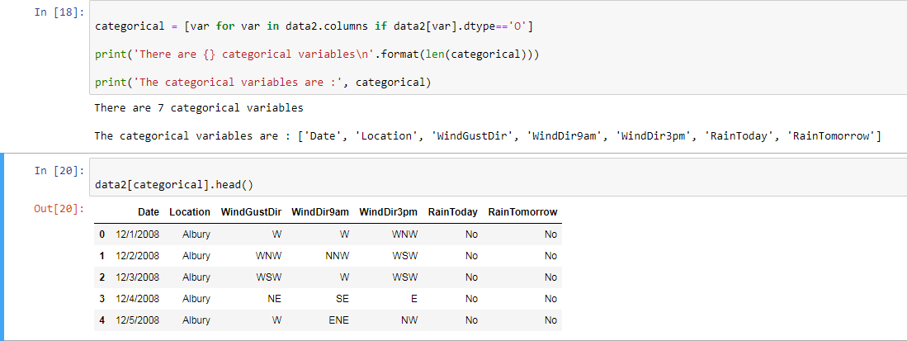
Preprocessing
checking categorical and numerical data
so we have 7 categorical variables

Slide 10
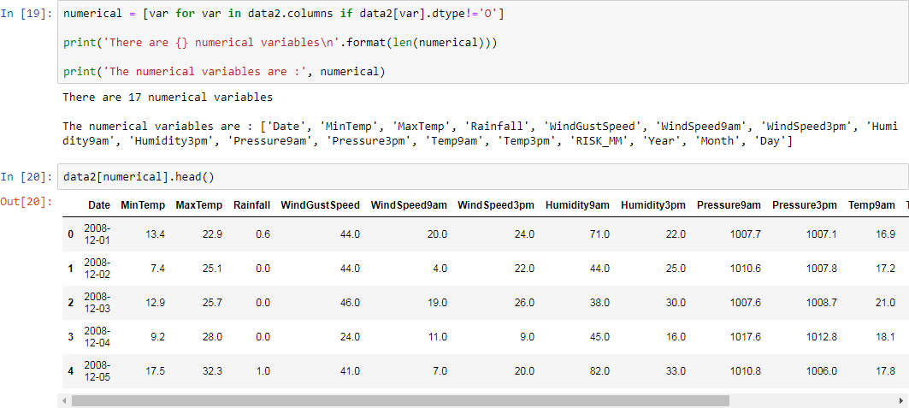
Preprocessing
and we have
17
categorical variables

Slide 11
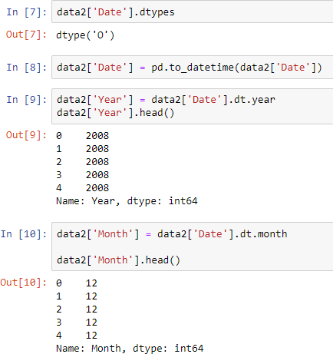
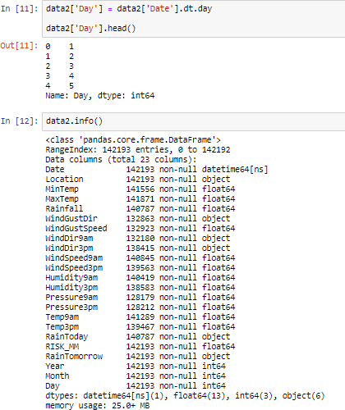
Preprocessing
as 'date' variable is object type we are extracting 3 diffrent (day
,month, year ) variables from 'date' variable which are of 'int' type.

Slide 12
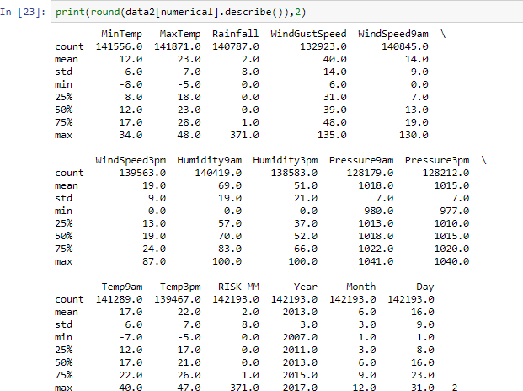
Visualization
On closer inspection, we can see that the Rainfall may contain outliers.

Slide 13
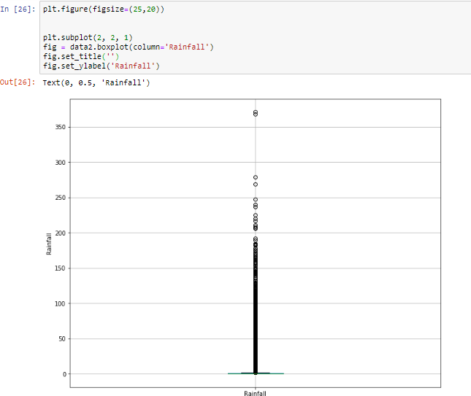
Visualization
This boxplot graph confirms that rainfall column has a lot of outliers.

Slide 14
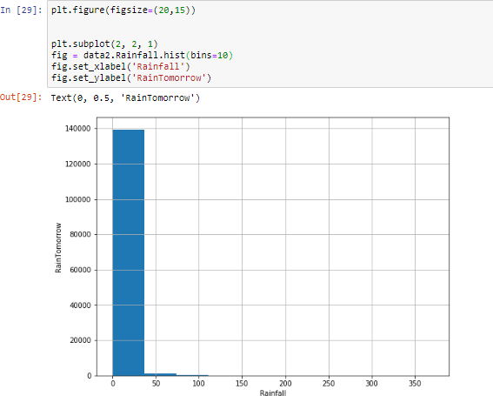
Visualization
Plotting histogram to check distribution is normal or skewed.

Slide 15
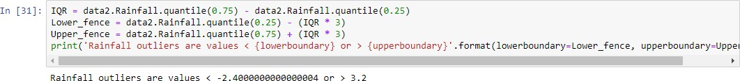
Visualization
as distribution is skewed we will use interquantile range to find outliers.
So Rainfall outliers are values < -2.4000000000000004 or > 3.2

Slide 16
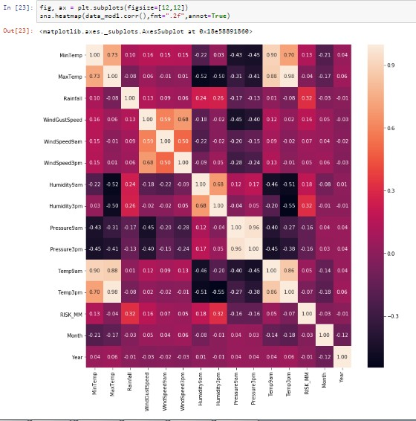
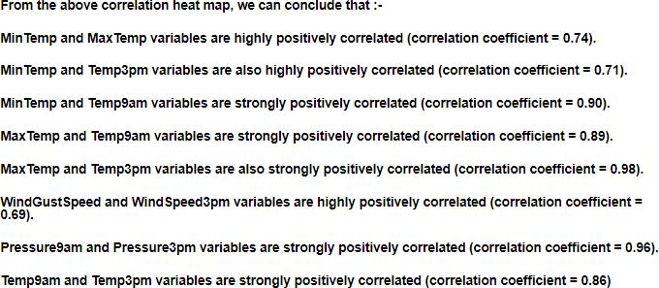
Visualising the correlations within Table
(Using heatmap)
Interpretation

Slide 17
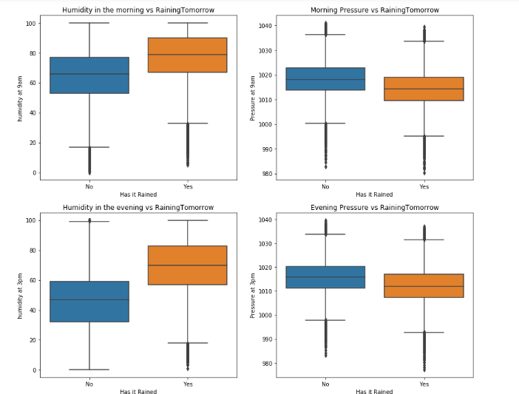
Visualization on the relations of Rainy
days and Humidity/Pressure
(Using boxplot)
As humidity increases proba bility of raining tomorrow is more.
As pressure increases proba bility of raining tomorrow is less.

Slide 18
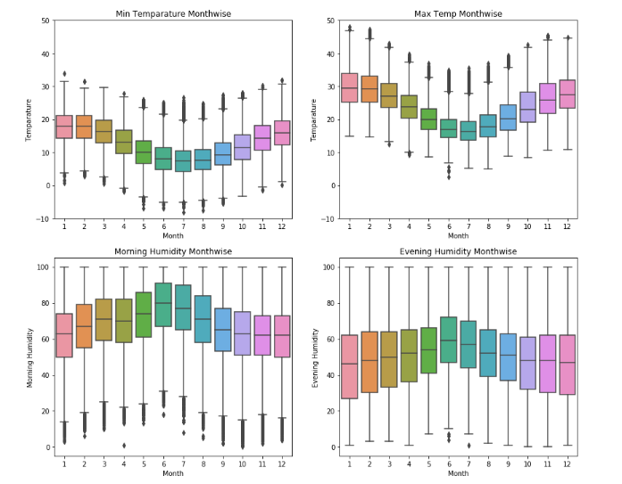
Visualization on monthwise comparision
of Temparature/Humidity
(Using boxplot)

Slide 19
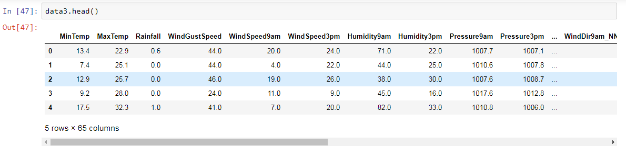
Standardization
Data before standardizing

Slide 20
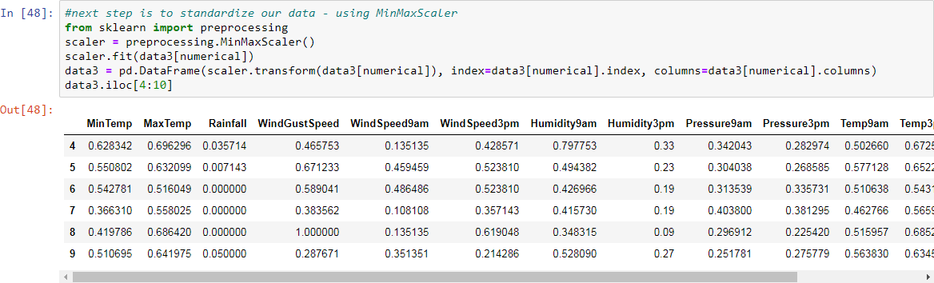
Standardization
Standardizing our data using 'MinMaxScaler'

Slide 21
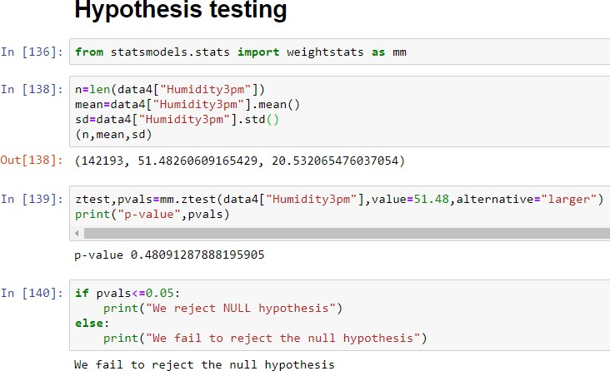
Hypothesis testing
As mean is 51.482 Null hypothesis: H0: Mean < 51.48
Alternate hypothesis:
H1: Mean>= 51.48
p-value= 0.4809
p-value > 0.05
so we fail to reject hypothesis.

Slide 22
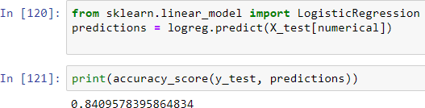
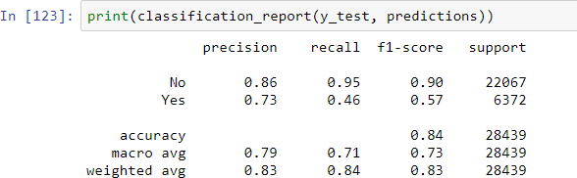
Prediction using Logistic Regression

